Slide 1
ADaM popPK Dataset for NONMEM® - A Programmer Point of View
Presented by Ya Wan & Lin Liu
Statistical Programmer
BeiGene

Slide 2
Meet the Speakers
Ya Wan
Title: Senior Principal Statistical Programmer
Organization: BeiGene
Ya Wan, currently a Senior Principal Statistical Programmer at BeiGene, has nearly 10 years of experience in the pharmaceutical industry, focusing on global clinical trials. Prior to BeiGene, she worked at Pfizer and Roche. Ya has extensive experience in various therapeutic areas, such as oncology, immunology, and inflammation.
She has a solid background in CDISC standards and contributes to the CDISC ADaM Oncology sub-team as a volunteer.
Ya holds a Bachelor's degree in Preventive Medicine and a Master's degree in Biostatistics from Nanjing Medical University.
Lin Liu
Title: Statistical Programmer II
Organization: BeiGene
Lin Liu, currently a Statistical Programmer II at BeiGene, focuses on both local and global clinical trials in different areas, such as oncology.
She actively applies CDISC standards in PK/ADA analysis to support in-house studies and promote standard process with cross functions.
Lin holds a Bachelor's degree in Chinese Medicine from Nanjing University of Chinese Medicine and Master's degree in Biostatistics from China Pharmaceutical University.

Slide 3
Disclaimer and Disclosures
The views and opinions expressed in this presentation are those of the author(s) and do not necessarily reflect the official policy or position of CDISC / BeiGene.
The author(s) have no real or apparent conflicts of interest to report.

Slide 4
Agenda
Introduction
General Workflow of ADPPK Development
General Dataflow of ADPPK
Typical Variables in ADPPK
Conclusion
References

Slide 5
Introduction

Slide 6
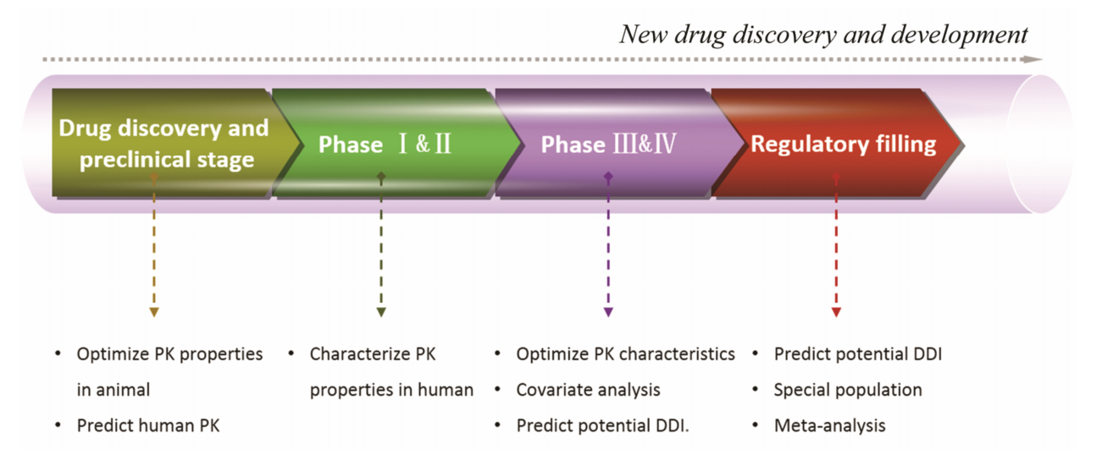
Introduction of Pharmacokinetic
Pharmacokinetic (PK)
Pharmacokinetic (PK) is the branch of pharmacology that studies how a drug moves through the body over time. It involves the processes of absorption, distribution, metabolism, and excretion (often abbreviated as ADME).
PK in Clinical Life-cycle
PK plays a critical role throughout the lifecycle at multiple points in the drug development process, e.g., IND, NDA and BLA, or post-marketing stage.
Figure 1. Drug development stages and the use of PopPK
*Source: Chen WJ, 2017, Population pharmacokinetics and its application in new drug research

Slide 7
Introduction of PopPK
Population PK (PopPK)
PopPK is a model-based representation of PK processes with a statistical component, enabling identification of the sources of inter- and intraindividual variability. It is suited for analysis of large heterogeneous PK datasets generated as part of standard multi-study clinical programs and often used as a basis for simulations to inform dose selection and other milestones of drug development.
PopPK performed regularly throughout the drug development cycle and represent important components of a regulatory submission dossier.
Figure 2. Timeline of popPK development
*Source: CDISC Basic Data Structure for ADaM PopPK Implementation Guide v1.0, 2023

Slide 8
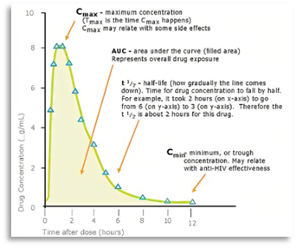
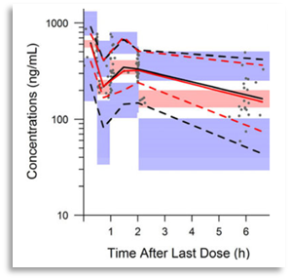
Introduction of PopPK: Individual PK vs. PopPK
Individual PK​
Derive PK parameters for each subject from concentration-time data (using non-compartment analysis [NCA]).​
Understand population pharmacokinetic property through PK parameters.​
Population PK​
•Derive the drug concentration from a large group of individuals to understand variability in drug response.
•Understand population pharmacokinetic property by the analysis on concentration-time data directly.
​
Individual PK | Population PK
Figure 3. Individual PK vs. PopPK

Slide 9
The Application of PopPK
Selecting dosing regimens to be tested in clinical trails
Identify the covariates that influence PK variability, dosing regimens can be tailored to mitigate variability in subsequent experimental designs. e.g., Relationship between body weight and drug exposure;
Serve as a predictive model to estimate PK characteristics under unknow doses or dosing intervals, aiding in the exploration of effective or safe dose ranges.
Deriving sample size and sampling scheme requirements
Based on the primary types of PK variability, such as large variability in Cmax, corresponding adjustments can be made to the timing and intervals of sampling to identify key PK characteristics, thus eliminating unnecessary sampling.
Deriving exposure metrics for conducting exposure-response (E-R) analysis
For drug-drug interaction (DDI) analysis
Pediatric trail designs
Simulations from PopPK models established from pediatric and adult date can be used to compare the exposure of the drug in pediatric patients and adults, and the derive the recommended pediatric dose.
At multiple points in the drug development process, e.g., IND, NDA and BLA, or post-marketing stage
*Source: Population Pharmacokinetics Guidance for Industry: Population Pharmacokinetics | FDA

Slide 10
PopPK Analysis Running on NONMEM®
PopPK Analysis Pathway
General Software Platforms for PopPK Analysis
NONMEM (Nonlinear Mixed Effects Modelling)
Monolix
Phoenix NLME
R
…
NONMEM® is a powerful software tool designed for the analysis of pharmacokinetic (PK) and pharmacodynamic (PD) data.

Slide 11
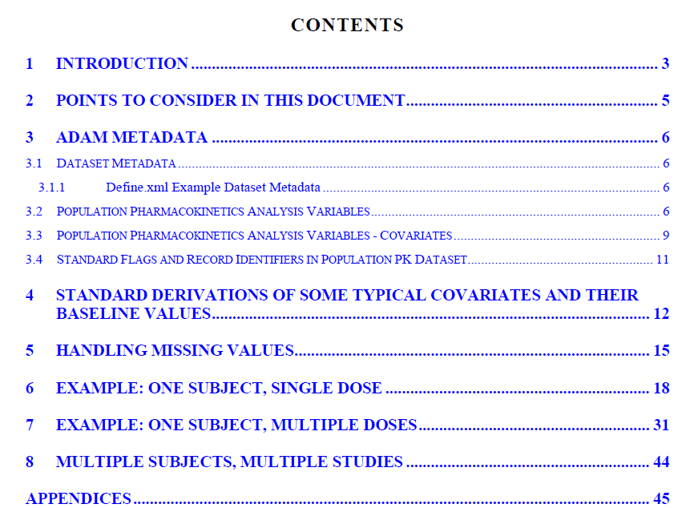
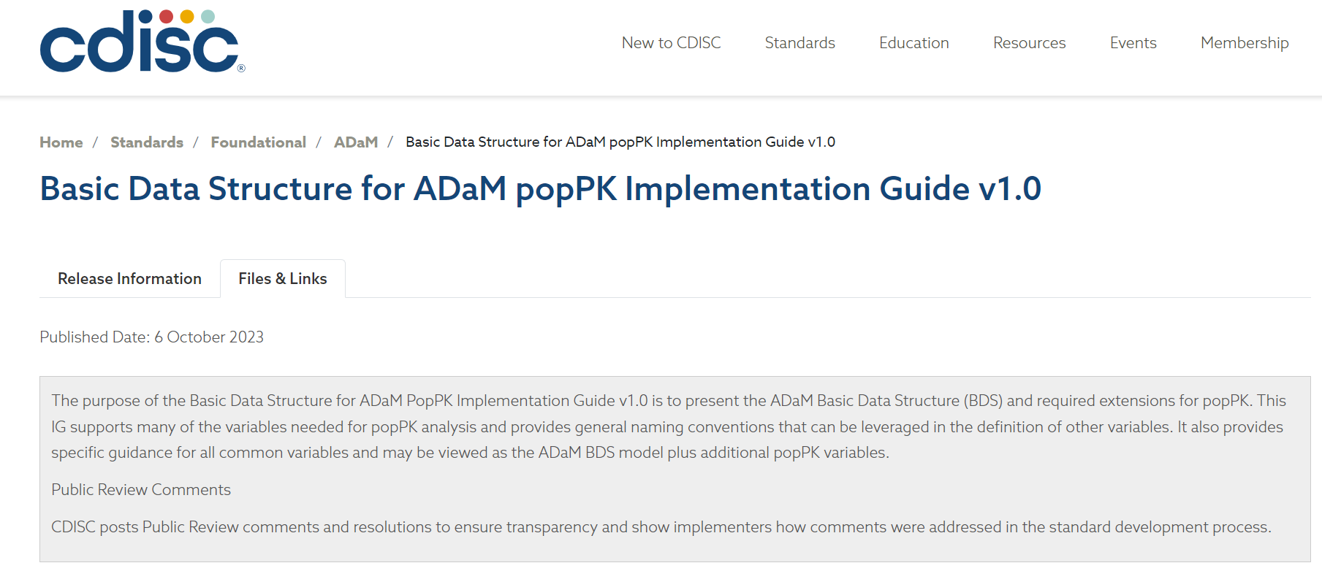
CDISC Guide about ADaM PopPK - ADPPK
Basic Data Structure for ADaM PopPK Implementation Guide v1.0
CDISC ADaM Population Pharmacokinetic Standards Development Team released the IG on 6 October 2023 to present the ADaM Basic Data Structure (BDS) and required extensions for popPK.

Slide 12
FDA Requirements of PopPK Datasets
Datasets Submissions
All datasets used for model development, validation, and simulations can be submitted as SAS transport (*.xpt) or comma delimited (*.csv) files.
Accompanying documents
A description of each dataset and associated variables can be provided in a define file (as an *.xml or *.pdf)
A Reviewer’s Guide file can also be provided and includes the following information:
Listing and description of all submitted analysis scripts, software, version, and package dependencies needed to run the analysis scripts
Specific order for execution
Flowchart and/or table depicting input and output files for each analysis script
Pop PK Study Report,
the corresponding programs, datasets, and define files under the datasets folder within the eCTD module 5.3.3.5.
*Source: Data format for pharmacometrics datasets and analyses submission: Model | Data Format | FDA

Slide 13
FDA Requirements of PopPK Datasets
eCTD Data Validation
eCTD validation for study data (Technical Rejection Criteria) WILL APPLY to the following eCTD sections:
4.2 Study Reports
5.3 Clinical Study Reports and Related Information
eCTD validation for study data (Technical Rejection Criteria) WILL NOT APPLY to the following eCTD sections:
4.2.1 Pharmacology
4.2.2 Pharmacokinetics
4.2.3.3 Genotoxicity
4.2.3.5 Reproductive and Developmental Toxicity
4.2.3.6 Local Tolerance
4.2.3.7 Other Toxicity Studies
5.3.1.3 In Vitro – In Vivo Correlation Study Reports and Related Information
5.3.1.4 Reports of Bioanalytical and Analytical Methods for Human Studies
5.3.2 Reports of Studies Pertinent to Pharmacokinetics Using Human Biomaterials
5.3.3.5 Population PK Study Reports and Related Information
5.3.5.3 Reports of Analyses of Data from More than One Study
5.3.5.4 Other Study Reports and Related Information
5.3.6 Reports of Postmarketing Experience
*Source: Electronic Common Technical Document (eCTD) | FDA

Slide 14
General Workflow of ADPPK Development

Slide 15
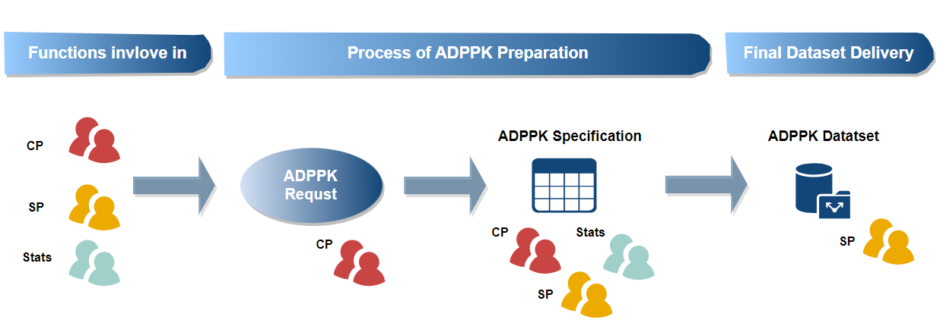
Working Process with Cross Functions
***Roles:
CP: Clinical Pharmacologist
Stats: Statistician
SP: Statistical Programmer

Slide 16
General Dataflow of ADPPK

Slide 17
ADPPK General Introduction
The ADaM Implementation Guide (ADaMIG) supports many of the variables needed for popPK analysis and provides general naming conventions that can be leveraged in the definition of other variables.
Data Structure
Define.xml Example Dataset Metadata
Data Structure Name | Data Structure Description | Class of Dataset | SubClass of Dataset | CDISC Notes
ADPPK | Basic Data Structure Population Pharmacokinetic Analysis | BASIC DATA STRUCTURE | POPULATION PHARMACOKINETIC ANALYSIS | Dataset designed to support PPK. Sourced from SDTM (e.g., PC, DM, EX, LB) and ADaM (e.g., ADSL and ADEX datasets).
Dataset | Description | Class - SubClass | Structure | Purpose | Keys | Documentation | Location
ADPPK | Population PK Analysis Dataset | BASIC DATA STRUCTURE • POPULATION PHARMACOKINETIC ANALYSIS | per parameter (analyte) per analysis timepoint per event (dosing or observation) | Analysis | USUBJID, AFRLT (Actual Rel Time from First Dose), DVID, EVID (event ID) | See program... | adppk.xpt

Slide 18
General Dataflow
Notes:
For time-varying covariates (e.g., weight at each visit), one records per analysis timepoint per subject;
otherwise for baseline covariates or subject-level covariates, one records per subject.

Slide 19
Programming Requirements for ADPPK Dataset
Data must be present in a text (i.e., ASCII) format flat file with appropriate delimiters.
The output dataset must not contain null values. Any null values should be replaced with dot (".").
NONMEM cannot accept character with space, "-", "," in non-null values, please replace such characters with "_" in all non-null values.
Both the continues and categorical covariates should not contain null values or dots. If the information is missing, set it to 99999. (specified by the Clinical Pharmacologist)

Slide 20
Typical Variables in ADPPK

Slide 21
PART 1: NONMEM® Specific Variables
C <Comment>
Flag for NONMEM to exclude records from the dataset.
EVID <Event ID>
EVID=1 is Dosing Event, EVID=0 is observation.
It can be expanded to other numbers as defined in the dataset specs.
DV<Dependent Variable Result>
Derived for EVID=0.
Numeric result of observation events. This is a copy of AVAL.
CMT <Compartment>
Derived based on the specifications from modeler.
DVID/DVIDN <Dependent Variable Name/(N)>
Flag indicates what is in the DV column.
Analyte name/other measurements (e.g., PC.PCTEST for PK, ADLB for labs).
MDV <Missing Dependent Variable Result>
Set to 1 when EVID=1 or DV is missing for EVID=0; else set to 0.
Assigned as 1 for EVID=1, other integers for EVID=0 (e.g., 2 for PK observation).
For infusion,
-Dose event, set to 1
-Sampling event (parent), set to 1
-Sampling event (metabolic, if exist), set to 2
For extravascular (oral, SC etc.),
-Dose event, set to 1
-Sampling event (parent), set to 2
-Sampling event (metabolic, if exist), set to 3

Slide 22
PART 1: NONMEM® Specific Variables
II <Dosing Interval>
Not recommended to use for infusion. For infusion, set to ".".
Describes the dosing frequency for multiple doses, e.g., 24 for QD, 12 for BID, etc., if time unit is hours.
ADDL <Number Of Additional Doses>
Not recommended to use for infusion. For infusion, set to ".".
Number of additional doses like the current dosing event until the next captured dose.
Example a: if a patient takes the same dose from Day 1 to Day 10 QD, and only 1 record in EX. PK sampling is on Day 1 and Day 5. Then final records in ADPPK for EVID=1 should be:
1 record for Day 1 (ADDL=0)
1 record for Day 2-4 (ADDL=2)
1 record for Day 5 (ADDL=0)
1 record for Day 6-10 (ADDL=4)
Example b: if a patient takes the same dose from Day 1 to Day 10 BID, and only 1 record in EX. PK sampling is on Day 1 and Day 5. Then final records in ADPPK for EVID=1 should be:
1 record for Day 1 (ADDL=1*2-1=1)
1 record for Day 2-4 (ADDL=3*2-1=5)
1 record for Day 5 (ADDL=1*2-1=1)
1 record for Day 6-10 (ADDL=5*2-1=9)

Slide 23
PART 2: TIME Related Variables
UDTC <Date and Time of the Event>
UDTC is essential to derive variables of datetime.
UDTC is equal to <PCDTC for PC records>/<EXSTDTC for dosing records>/ <LBDTC for PD records>.
Imputations should be avoided as much as possible, although may be required in cases where complete dosing history is not available. It is important to have CRFs that collect the required information. (CDISC ADPPK IG, Section 5 Handling Missing Values)
Example when the drug is taken orally, impute the dosing time according to the following order:
Derived from "Study drug dose date and time of reference time point" field of "PK Sampling" page in the CRF firstly. If this field is not collected, use "Date and time of last dose prior to pre-dose PK sample" field.
Use most recent non-missing postdose sampling time within a dose interval to subtract the interval between sampling and drug administration to fill in.
If no postdose sampling is collected, use predose sampling time to plus the interval between sampling and drug administration to fill in if the protocol specifies an interval between pk sampling and drug administration.
If time is still missing, then assigned as the first dose time.
Example for b): dosing time = postdose 2h sampling time - 2h.
Example for c): protocol defines the predose sampling is on 30min before dosing, then dosing time = predose sampling time + 0.5h.
If not, skip this step.

Slide 24
PART 2: TIME Related Variables
AFRLT <Actual Rel Time From First Dose>
AFRLT = sample/dose datetime - the first dosing start datetime.
APRLT <Actual Rel Time From Previous Dose>
For dosing records, set to 0.
For non-dosing event, APRLT = sample datetime - last previous dose start datetime. For sampling prior to the first dose, APRLT = sample datetime - first dose start datetime.
For cases using ADDL, dose datetime should be taken the dose start datetime after folding.
For example, if a patient takes dose from D1 to D10, PK sampling is on D1 and D5. Combined with ADDL, this dosing record will be output into 4 records (i.e., D1, D2-D4, D5, D6-D10). The AFRLT for each of these four records should be calculated by subtracting the first dosing start datetime from the start datetime of D1, D2, D5, and D6, respectively.
Additional rules can be specified by the Clinical Pharmacologist,
e.g., if time part is missing and sampling prior to the first dose, set to 0; else if time part is missing, set to 99999.
Notes:
Note: for non-PK and non-dosing observations, if only date available and time is not collected,
AFRLT = (sample date - the first dosing start date) * 24.
APRLT = “.”.
For cases using ADDL, the practice is firstly to split dose records into each day, and derive all ADPPK variables per spec. Finally derive ADDL, and update some variables affected by folding, e.g., AFRLT need to be re-derived.

Slide 25
PART 2: TIME Related Variables
NFRLT <Nominal Rel Time From First Dose>
Planned elapsed time from the first exposure to study treatment per protocol.
If sampling plan time prior to the first dose is not clear in the protocol (e.g., only "predose" specified in the protocol), then set to 0; else if sampling plan time is not clear, then set to 99999.
Example a: PK sampling schedule (1 Cycle=21 Day, QD, the first dose is on C1D1):
C1D1 predose (within 60 min) --> NFRLT=-1
C1D1 1h (+/- 10 min) postdose --> NFRLT=1
C1D2 predose (within 60 min) --> NFRLT=23
C2D1 predose (within 60 min) --> NFRLT=21*24-1
C2D1 1h (+/- 10 min) postdose --> NFRLT=21*24+1
Example b: PK sampling schedule (1 Cycle=21 Day, QD, the first dose is on C1D1):
C1D1 predose --> NFRLT=0
C1D1 1h (+/- 10 min) postdose --> NFRLT=1
C1D2 24h (+/- 60 min) postdose/predose --> NFRLT=24
C1D3 24h (+/- 60 min) postdose/predose --> NFRLT=48
C2D1 predose --> NFRLT=21*24
C2D1 1h (+/- 10 min) postdose --> NFRLT=21*24+1

Slide 26
PART 2: TIME Related Variables
NPRLT <Nominal Rel Time from Previous Dose>
For dosing records, set to 0.
For non-dosing event, derive from planned elapsed time to the last previous dose per protocol. For sampling prior to the first dose, derive from planned elapsed time to first dose per protocol.
If sampling plan time prior to the first dose is not clear in the protocol (e.g., only "predose" specified in the protocol), then set to 0; else if sampling plan time is not clear, then set to 99999.
Example a: PK sampling schedule: (1 Cycle=21 Day, QD)
C1D1 predose --> NPRLT=0
C1D1 1h (+/- 10 min) postdose --> NPRLT=1
C1D2 24h (+/- 60 min) postdose/predose --> NPRLT=24
C1D3 24h (+/- 60 min) postdose/predose --> NPRLT=24
C2D1 predose --> NPRLT=24
C2D1 1h (+/- 10 min) postdose --> NPRLT=1
Example b: PK sampling schedule: (1 Cycle=21 Day, Q3W)
C1D1 predose --> NPRLT=0
C1D1 1h (+/- 10 min) postdose --> NPRLT=1
C1D1 24h (+/- 60 min) postdose/predose --> NPRLT=24
C1D1 48h (+/- 60 min) postdose/predose --> NPRLT=48
C2D1 predose --> NPRLT=21*24
C2D1 1h (+/- 10 min) postdose --> NPRLT=1

Slide 27
PART 3: Variables for CP Inputs
EXCLF/EXCLFCOM
Record Exclusion/Comment for the Record Exclusion.
Can be captured prior to the modeling or after some analysis, with possible iterations and adjustments.
FLGREAS/FLGREASC
Identification of Data Issue Reason.
Captures primary reason for identifying the record for data issues (e.g., dose time imputation flags).
Examples of the exclusions or reasons：
Missing sample information
Post-first dose LLOQ or BLQ
Day 1 pre-dose samples
Duplicate samples with different concentrations
Concentration value outliers
Imputed missing dose amount with nominal/actual dose
Actual dose deviates from planned/nominal dose
Imputed dose time
Imputed infusion duration
……

Slide 28
PART 4: Covariates
GENERAL NOTES
Source:
ADSL, ADLB, ADVS, ADBASE, …
Derivation and formulas based on study protocol/SAP.
Missing values:
Leave as missing (code to a numeric number if tool does not accept missing; e.g., -99, 99999).
WT - Weight (kg)
WTBL - Baseline Weight (kg)
HTBL - Baseline Height (cm)
BMIBL - Baseline Body Mass Index (kg/m^2)
BSABL - Baseline Body Surface Area (m^2)
ECOGBL - Baseline ECOG
TBIBL - Baseline Total Bilirubin
ASTBL - Baseline Aspartate transaminase
ALTBL - Baseline Alanine transaminase
CRCLBL - Baseline Creatinine Clearance Derivation
CRCL={((140–age) x WT)/(72xSCR)} x 0.85 [if female]
where:
CRCL (creatinine clearance) = mL/min
Age (years)
WT (kg)
SCR (serum creatinine) in mg/dL
1 mg/dL=88.4017 µmol/L

Slide 29
PART 4: Covariates
GFR = 141 x min(Scr /k, 1)^a x max(Scr /k, 1)^(-1.209) x 0.993^Age x 1.018 [if female] x 1.159 [if black]
where:
a is -0.329 for females and -0.411 for males,
min indicates the minimum of Scr /k or 1,
and max indicates the maximum of Scr /k or 1.
When unit of Scr is µmol/L, k is 61.9 for females and 79.6 for males,
when unit of Scr is mg/dL, k is 0.7 for females and 0.9 for males,
Treatment-emergent ADA
ADA Titer
ADA Onset (day)
ADA Duration (day)
EGFRBL - Baseline eGFR
HEPAIMP - Hepatic Impairment Grade
RENAIMP - Renal Impairment Grade
…
NCI-ODWG criteria based on TB & AST:
GROUP A: Normal (total bilirubin ≤ULN and AST ≤ULN)
GROUP B: Mild (total bilirubin > 1.0x-1.5xULN or AST > ULN)
GROUP C: Moderate (total bilirubin > 1.5x-3xULN)
GROUP D: Severe (total bilirubin > 3xULN)
The values of the lab covariates should be considered at baseline.
NCI: 0-normal; 1-mild; 2-moderate; 4-severe.
Child-Pugh: 1-Risk A; 2-Risk B; 3-Risk C.
Derived from one of the following conditions:
-Control (normal), set to 0, if Renal Function is ≤ 90
-Mild, set to 1, if Renal Function is 60-< 90
-Moderate, set to 2. if Renal Function is 30-< 60
-Severe, set to 3, if Renal Function is 15-< 30
-End Stage Renal Disease (ESRD), set to 4, if Renal Function is not missing and < 15 not on dialysis/Requiring dialysis.
EGFRBL is used for Renal Function as priority.

Slide 30
Conclusion

Slide 31
Some Challenges Faced by Programmers
Expertise Gap
Need for specialized knowledge and experience
Limited availability of skilled professionals
Stakeholder Communication
Ensuring effective communication and collaboration among stakeholders
Managing diverse stakeholder expectations
Standard Specification Development
Establishing uniform guidelines and best practices
Ensuring consistency across project teams
Handling variations to address the unique requirements of different drugs

Slide 32
References
Basic Data Structure for ADaM PopPK Implementation Guide-Version 1.0.
Population Pharmacokinetics Guidance for Industry (Population Pharmacokinetics | FDA).
FDA eCTD Technical Conformance Guidance.
Chen WJ, Zhou TY, Lu W. 2017. Population pharmacokinetics and its application in new drug research.
Rebecca H, Mitali G. 2024. An End User’s Perspective of Clinical Dosing Data Used for Population PK / PD Analysis with Nonlinear Mixed Effects Modeling.
Namrata P. 2020. Population PK Data Sets – Basic Concepts and Challenges from the Perspective of a SAS Programmer.
Raghu K. 2014. NONMEM® – A Programmer point of view.
Humphrey RL, Gaurav M, Rahatekar S, Nevarez J. 2024. Capture and Use of Meaningful Data for Population PK/PD Analysis with Non-Linear Mixed Effects Modeling.

Slide 33
Thank You!

