Slide 1
ICH M11 Clinical Electronic Structured Harmonized Protocol
Ron Fitzmartin, PhD, MBA
Center for Biologics Evaluation and Research
Food and Drug Administration
ICH M11 Rapporteur
10 July 2023

Slide 2
FDA Disclaimer
The views and opinions presented here represent those of the speaker and should not be considered to represent advice or guidance on behalf of the U.S. Food and Drug Administration.

Slide 3
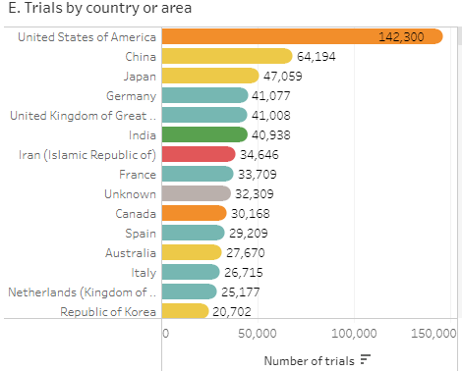
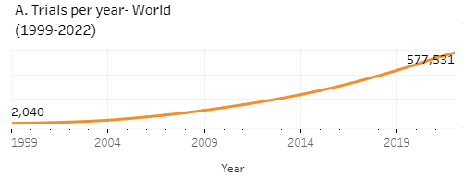
577,531
Interventional Clinical Trials in 2022
That’s a lot of protocols!
Number of trial registrations by location, disease, phase of development, age and sex of trial participants (1999-2022) (who.int)

Slide 4
Agenda
Introduction to ICH M11
Value of a Structured Harmonized Protocol
Scope and Breadth of M11’s Work Plan
The Guideline & Template
The Technical Specification
Next Steps

Slide 5
Introduction to the International Council for Harmonization (ICH)
ICH was founded in 1990
Mission
Greater harmonization worldwide to ensure safe, effective, and high-quality medicines are developed in the most resource efficient manner.
Global Platform
Brings together regulatory authorities and biopharma industry to discuss scientific and technical aspects of product development
Develop guidelines and technical specifications in four broad workstreams: Quality, Efficacy, Safety, and Multidisciplinary.
Impact
Once implemented by regulators the guidelines and technical documents form a common worldwide backbone of technical requirements for product development.
5

Slide 6
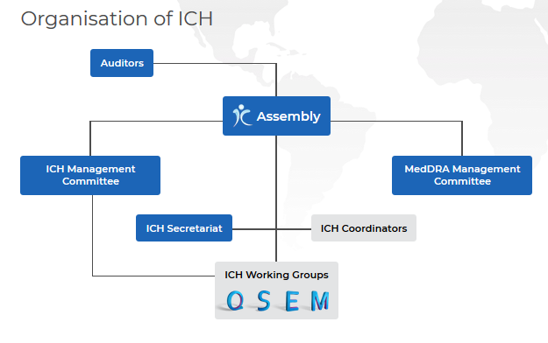
ICH Structure and Governance
M11 Expert Working Group (EWG)
Adapted from https://www.ich.org/page/organisation-ich

Slide 7
ICH M11 Expert Working Group
Regulatory Members​
ANVISA, Brazil​
CDSCO, India
EC, Europe​
FDA, United States​
Health Canada, Canada
HSA, Singapore​
MHLW / PMDA, Japan​
National Center, Kazakhstan
NMPA, China​
SFDA, Saudi Arabia
TFDA, Chinese Taipei ​
Industry Members​
BIO​
EFPIA​
IFPMA
IGBA​
JPMA​
PhRMA​
Source: https://ich.org/page/multidisciplinary-guidelines

Slide 8
Steps in the ICH Process
Adoption by Regulators
Sign-off, endorsement and adoption can be achieved at a face-to-face meeting or electronically
We are here
working toward Step 3 Signoff in 2024
Sign-off by Regulatory Topic Leaders
Endorsement
a. by Assembly
b. by Regulators
Step 5
Implementation
Step 4
Adoption of an ICH Harmonised Guideline
Step 3
Regulatory Public consultation, Reconciliation, and Sign-off
Sign-off by Topic Leaders
Step 2
a. ICH Parties consensus on Technical Document b. Draft Guideline adoption by Regulators
Step 1
Consensus building - Technical Document

Slide 9
ICH M11 Deliverables
ICH M11 developed a new harmonized guideline on the clinical protocol
Guideline is a high-level document that:
Provides the background on why a harmonized clinical protocol template is needed, and
How we developed the template and technical specification (for electronic exchange)
Key Deliverables
A Template to include identification of headers, common text, instructions, data fields and terminologies.
A Technical Specification that will use an open, nonproprietary standard to enable electronic exchange of the clinical protocol information

Slide 10
Why an M11 Expert Working Group?
No internationally harmonized standard template for the format and content to support consistency across countries, sponsors and exchange of protocol information.
Lack of harmonization contributes to inefficiencies and difficulties in reviewing and assessing clinical protocols by regulators, sponsors, ethical oversight bodies, investigators, and other stakeholders.

Slide 11
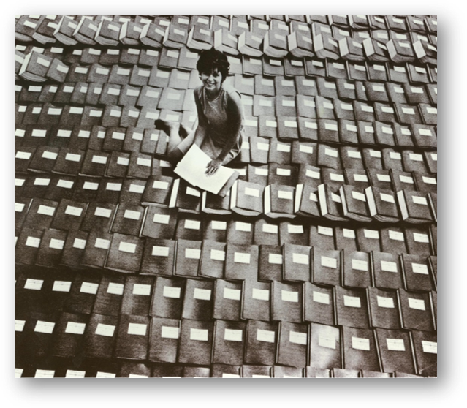
Why Clinical electronic Structured Harmonized Protocol (CeSHarP)?
Paper Regulatory Submissions… Not like this anymore…
…but this isn’t much better!

Slide 12
Value of an ICH Protocol Template
Predictability
Format and Structure – Table of Contents
Core Content – common set of information
Allows flexibility – recommended and optional text / sections
Common instructions – unnecessary repetition is eliminated
Serves all stakeholders – e.g., sponsor, investigators, regulators, site staff, IRBs
Consistent with all other relevant ICH Guidelines, where possible
Acceptable in all ICH countries

Slide 13
ICH M11 Scope
The Template and Technical Specification are applicable to interventional clinical trials of medicinal products across all phases and therapeutic areas of clinical research.
Out of Scope
Guideline, Template and Technical Specification do not specify processes related to development and maintenance of a protocol.
Template and Technical Specification do not provide instruction on the development of a well-designed trial or characterize a well-crafted final protocol.
Template and Tech Specification do not supersede or negate other guidelines that establish requirements for protocol content.

Slide 14
Value of an Electronic ICH Protocol Template
Protocol will be data-driven . . .
Tailored User Experience
Task or role-based views of the content
Personal views– have the information served up the way you want it
Collaboration
Multi-sponsor development programs
Regulator to Regulator Reviews
Downstream Automation
Clinical Trial Registries
Data Capture
Statistical Analysis Plan
Clinical Study Report
Other Protocols
Future
Capability to compare / contrast trial designs across sponsor submissions
Perform “what / if” scenarios on trial design, arms, interventions, etc.
Notes:
Searchable content and metadata
Indication
Population
Drug class
Sponsor(s)
Procedures
Amendment history and changes
Collaboration and Continuity
Transition of molecules via mergers/acquisitions
Multi-sponsor studies
Data integration
Tailored experience
Side-by-side comparison of fields or sections
Task- or role-based views
Downstream automation
Population of CT Registry
Content reuse to SAP, CSR, other protocols
Future standardization and automation
Machine-readable SoA
Traceability: Estimand →SoA → Results → Label
Downstream reuse of content
Downstream reuse of design details (feasibility, costing, grant payments)

Slide 15
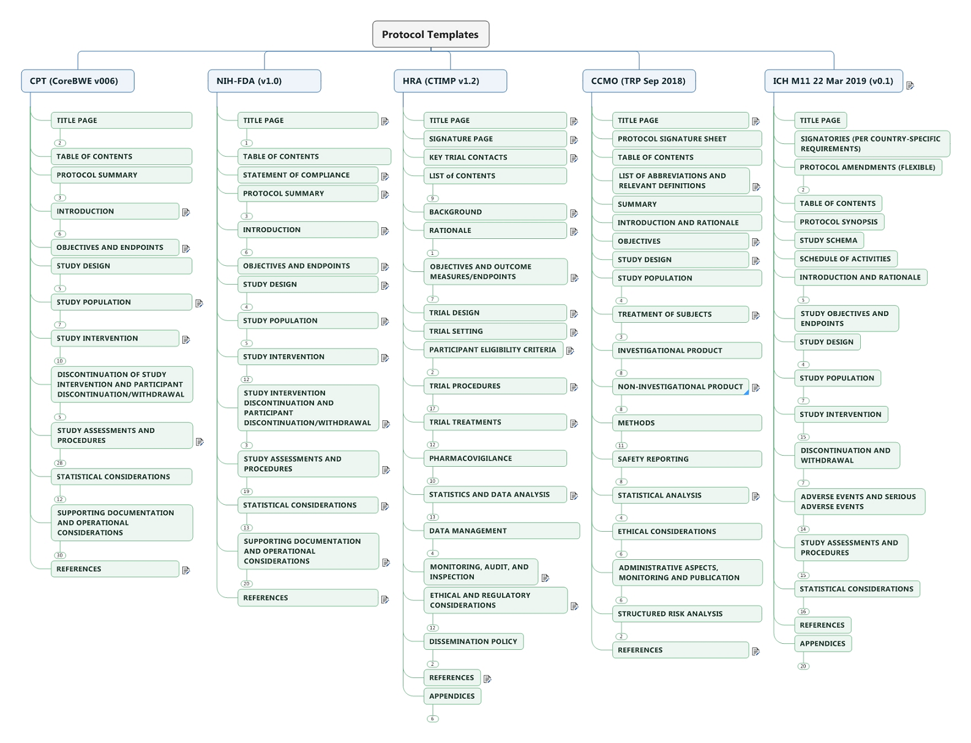
M11 Scanned the Protocol Template Landscape…2018
15
1. TCB, 2. NIH-FDA, 3. NHS Health Research Authority, UK, 4., Central Committee on Research, NL

Slide 16
Breadth of M11’s Consultation to Ensure Consistency
Structure & Content of Clinical Study Reports
E3
Ethnic Factors in Acceptability of Foreign Data
E5
Good Clinical Practice
E6
General Considerations in Clinical Trials
E8
Statistical Principles for Clinical Trials
E9
Clinical Trials in Pediatric Populations
E11
Multi-Regional Clinical Trials
E20
E17
Adaptive Clinical Trials
Electronic Standards
M2

Slide 17
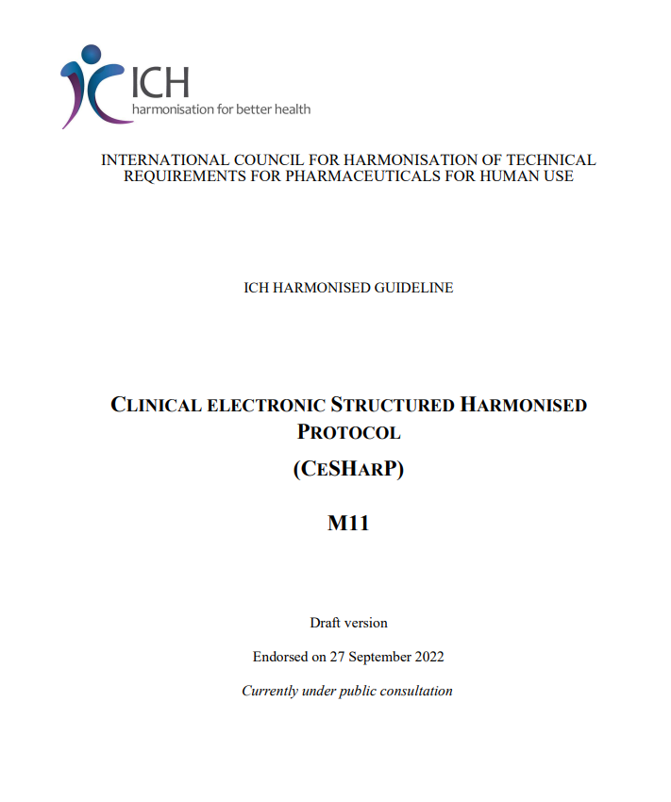
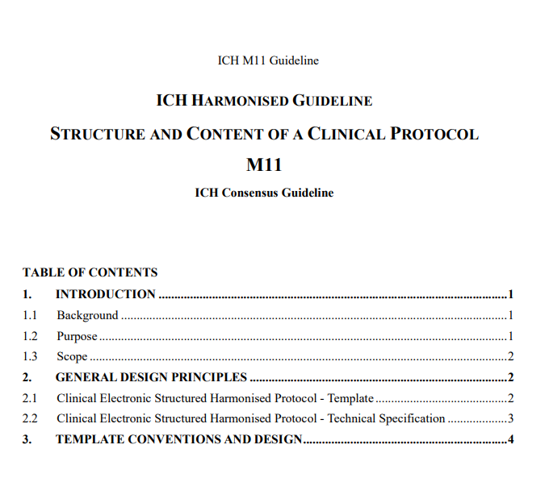
ICH M11 Guideline
Guideline describes the approach used to develop the two other deliverables:
Background
Purpose
Scope
General design principles, e.g.,
Avoid unnecessary duplication of content
Use cross-referencing
Avoid multiple terms for the same thing
Introduce more structured content, where possible
Used established terms / definitions
Page 17

Slide 18
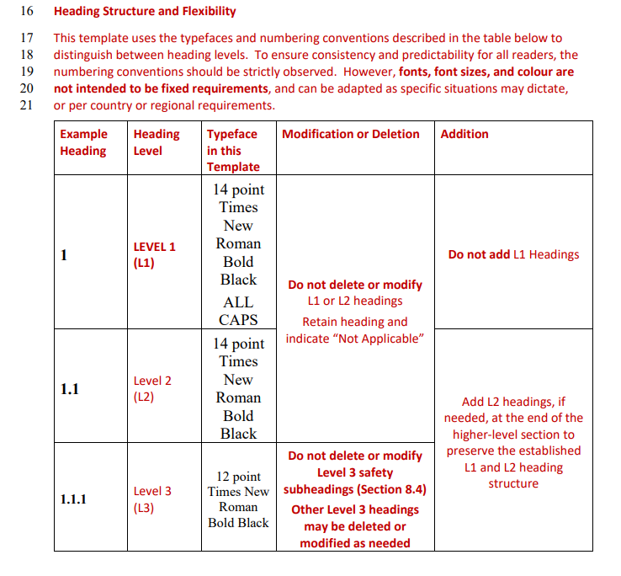
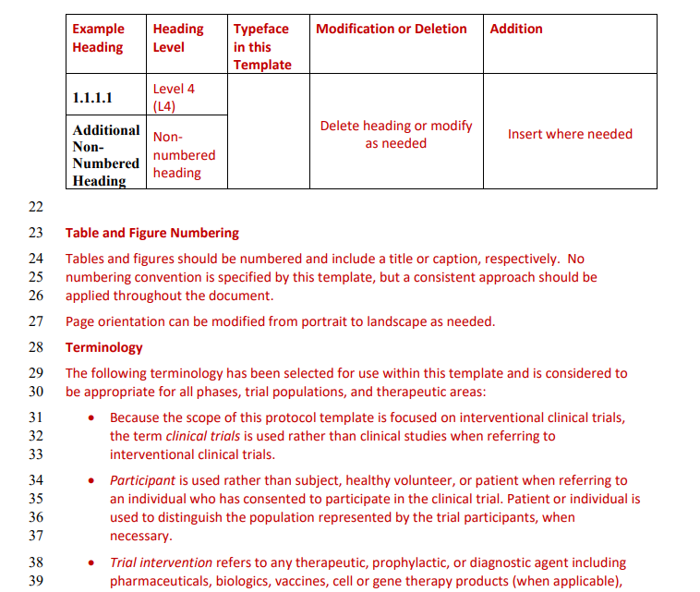
ICH M11 Protocol Template
Preamble to the ToC
Conventions
General header & structure guidance
Explanation of terms
Notes:
Build common core content - The template design represents a core set of information for a clinical trial of any medicinal product(s).
Serve the needs of stakeholders - The template’s structure and content provide a framework for relevant stakeholders to develop, review and implement protocols that consistently and unambiguously include a uniform table of contents, common section headers and content, as well as common terminologies.
Define content for electronic exchange - The protocol content can be electronically exchanged among parties, including sponsors and regulators, using current (for example, electronic common technical document) and other future technologies.
Design for content re-use - The clinical protocol is a rich source of information that can be re-used as part of the clinical trial management and review process, and, for example, published on clinical trial registries to promote clinical trial transparency and used in standardised clinical trial data capture.
Maintain flexibility - The template incorporates both recommended and optional text and data fields to maintain flexibility. Higher-level heading structure is conserved, while lower-level sections can be added, removed, or modified as needed.

Slide 19
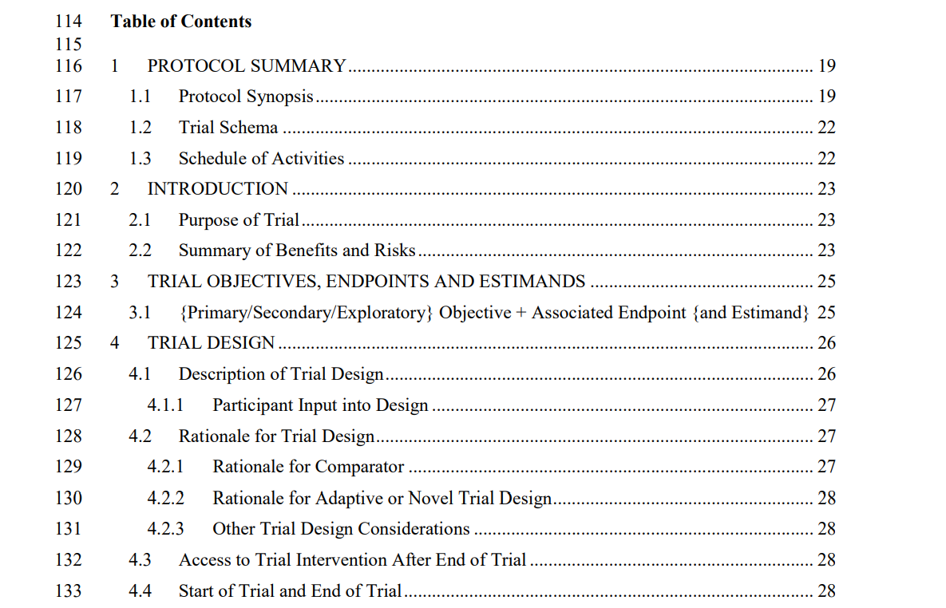
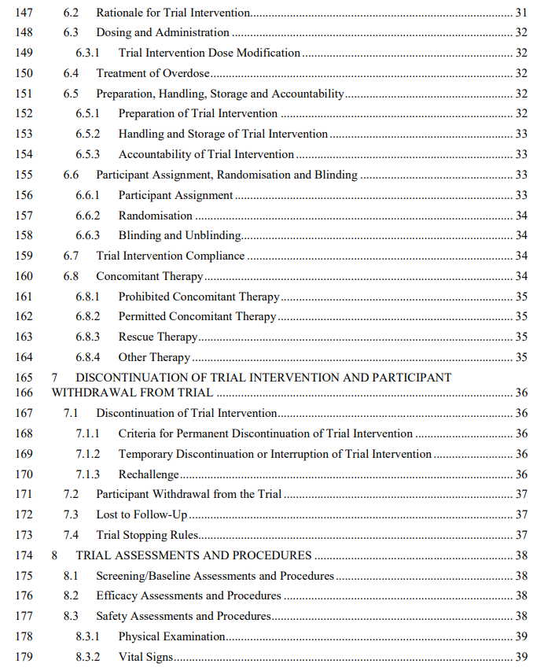
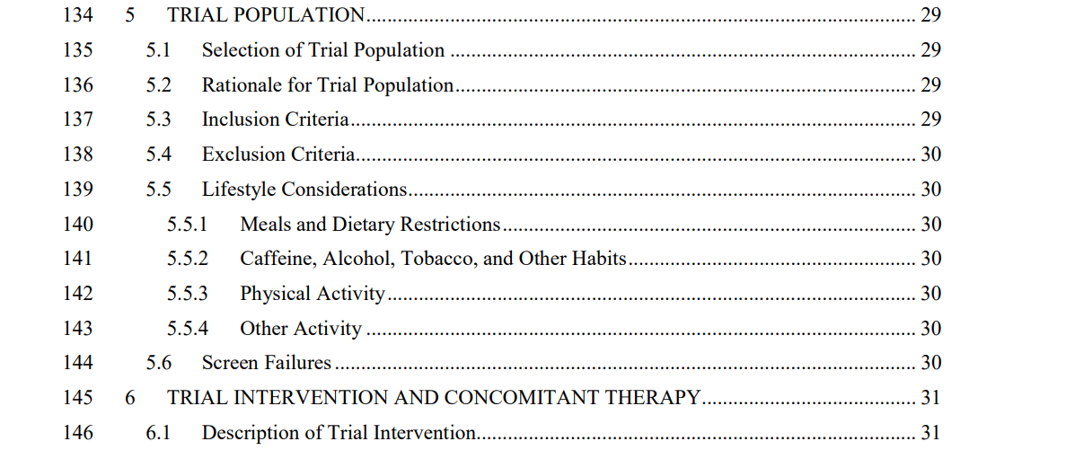
ICH M11 Template - Table of Contents

Slide 20
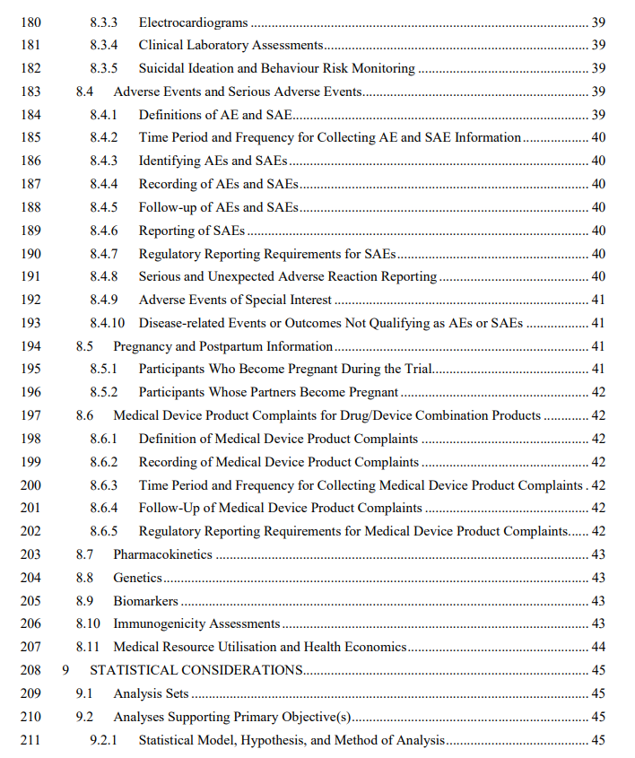
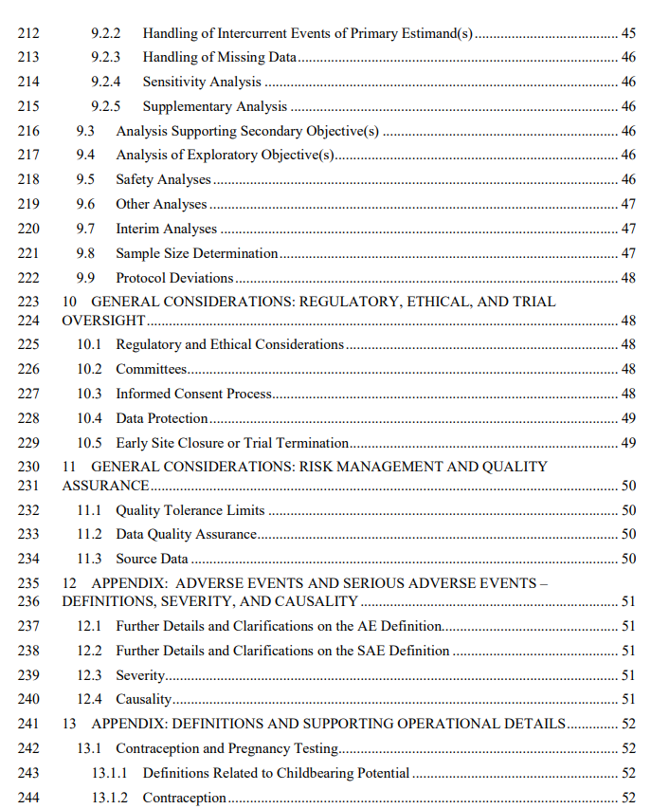
ICH M11 Template - Table of Contents

Slide 21
ICH M11 Technical Specification
The Technical Specification includes:
Business requirements and common structured protocol content components – the data and metadata.
Conformance, cardinality, and other technical attributes that enable the electronic exchange of protocol content
An open, non-proprietary standard for electronic exchange enables development of interoperable electronic tools to facilitate exchange, review, and execution of protocols.
Notes:
The tech spec is an even more concise articulation of the contents and instructions provided in the template
Ensuring congruence between the tech spec and the protocol template led to more precision in the structure and instructions for both
Review of the tech spec may reveal details that will be important during implementation that may not have been entirely obvious by reading the template alone

Slide 22
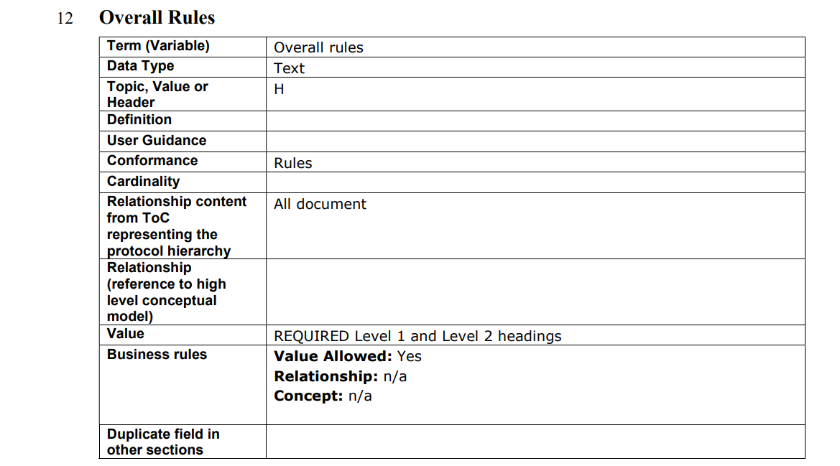
ICH M11 Technical Specification
The Technical Specification includes
detailed descriptions of the structured content components
specific data fields
blocks of text-based content
other defining attributes
business rules as established in the Template

Slide 23
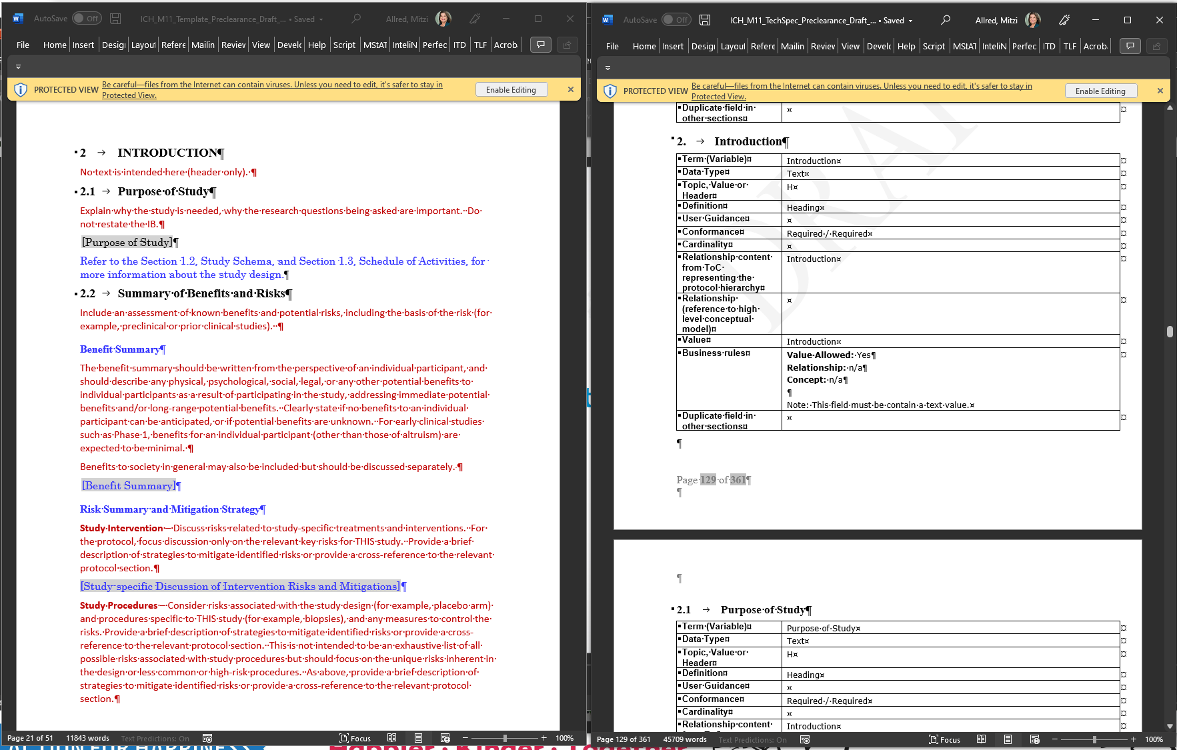
Reading the Technical Specification
M11 Technical Specification follows the Template outline
Best to have the template available when reading the Tech Spec.

Slide 24
M11-M2 Technical Development Process
Guideline
Protocol Template
Models support exchange and storage of information (Data and Content)
Content Model
“Basis of Requirements Sheet”
Describes how content is structured, sequenced and related.
Usage: Machine-friendly specification for content
We are here
Basis of Requirements
Conceptual Model
Logical Model
XML Schema/SDO Development*
Describes how business concepts are related to entities conceptually at the highest level
Describes how Entities are related, includes details like how entities are connected, which unique ID connects it etc.
Describes how information can be read
Usage: Information Exchange and APIs
Technical Specification
Example (Message Exchange)
(Future State)
DRAFT ICH Technical Implementation Guide
*example HL7 Vulcan/
CDISC

Slide 25
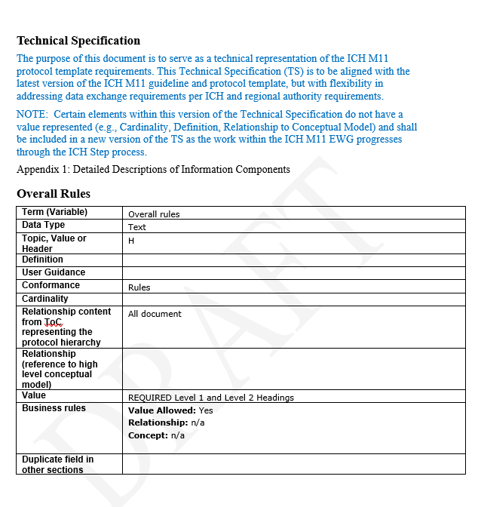
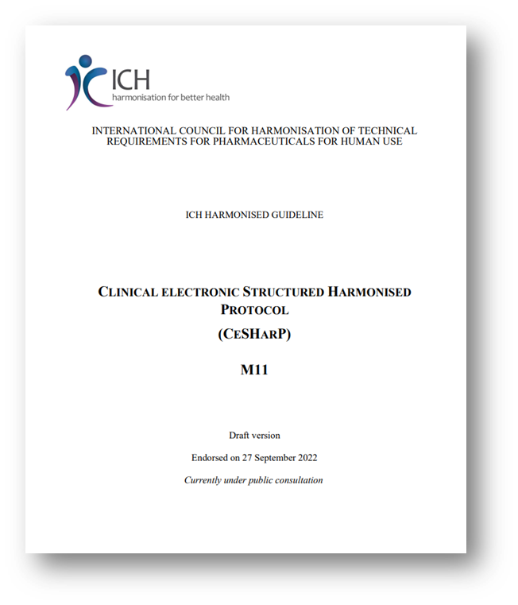
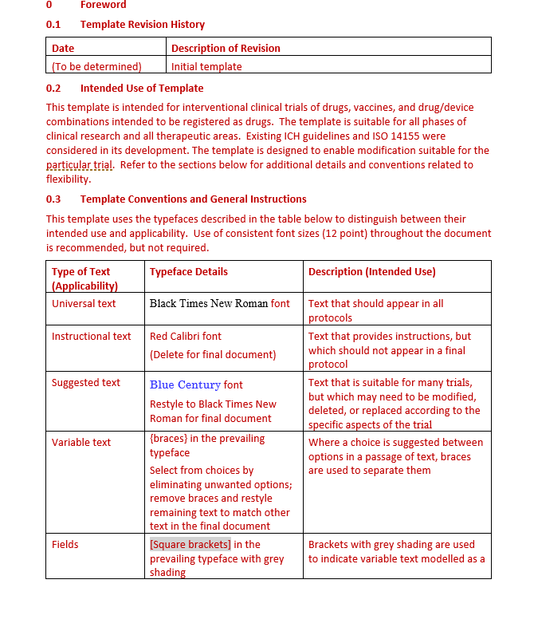
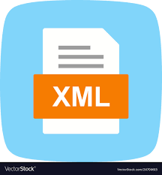
M11-M2 Technical Development Process
Technical Implementation Guide
Guideline & Template
Tech Spec
FHIR
Profiles
Stylesheet
Electronic Document
Human Readable Form
Standard Message Exchange Formats*
Machine- Readable Form
...
Per ICH Regional Requirements
* Technical Implementation Guides may be needed for various use cases

Slide 26
Our M11 Journey: 2018 - 2024
Planned Step 3 Sign-Off -> Step 4 Adoption
M11 Collaborations with EWGs
Concept Paper
Jan-Feb: WGs formed with E9(R1) & M2
May: Virtual Meeting on E9 content integration and technical specification
Informal party review
November: Virtual Meeting –E9(R1) feedback
Prep for Party Review
Step 1 –> 2a/2b –> Step 3
Update all documents
Step 3 Sign-off
Step 4 Adoption of the Guideline, Template and Technical Specification
June: Concept Paper endorsed in Kobe, JP
November: Charlotte, USA 1st EWG Meeting
Updated all documents
September: Step 1 Sign-off Amsterdam
September: Steps 2a/2b
October: Entered Step 3
2019
2021
2023
2018
2020
2022
2024
The 1st Draft
Party Review (Pre-Step 1)
Public Comment Adjudication
1st Draft Structure
May: Amsterdam (2nd F2F)
Consensus on structure
Party Review of 1st draft
November: Singapore (3rd F2F)
May: Virtual Meeting on structure, content, design principles
November: Virtual ICH Meeting – preparing for Step 1
Complete Step 3 regional public consultation period
Adjudicate regional public consultation results
Update guideline, template and technical specification
Regional Party Review
Develop FHIR Technical Implementation Guide
Plan Step 3 Sign-off

Slide 27
Next Steps
Adjudication of ~2,300 public comments received by 11 regulatory agencies across the 3 documents.
Update Guideline, Template and Technical Specification.
Continue the work with HL7 Vulcan – CDISC to develop FHIR profiles for a M11 focused exchange standard (Technical Implementation Guide).
Continue work with CDISC to develop new standardized terms and definitions that are M11 protocol template-specific.
Plan for Step 3 Sign Off and Step 4 Adoption in 2024.

Slide 28
Thank You

